Slide 1
Re-Imagining Accessibility Guidelines
https://goo.gl/1dyJck

Slide 2
Background
Web Content Accessibility Guidelines (WCAG) 2.0 published in 2008
WCAG 2.1 currently in process (finished in 2018)
What’s the next major upgrade?
Notes:
The W3C Accessibility Guidelines Working Group recognized the difficulty in maintaining the Web Content Accessibility Guidelines (WCAG), and decided to redesign the guidelines to more easily and effectively evolve to match the progression of technologies and the needs of people with disabilities.

Slide 3
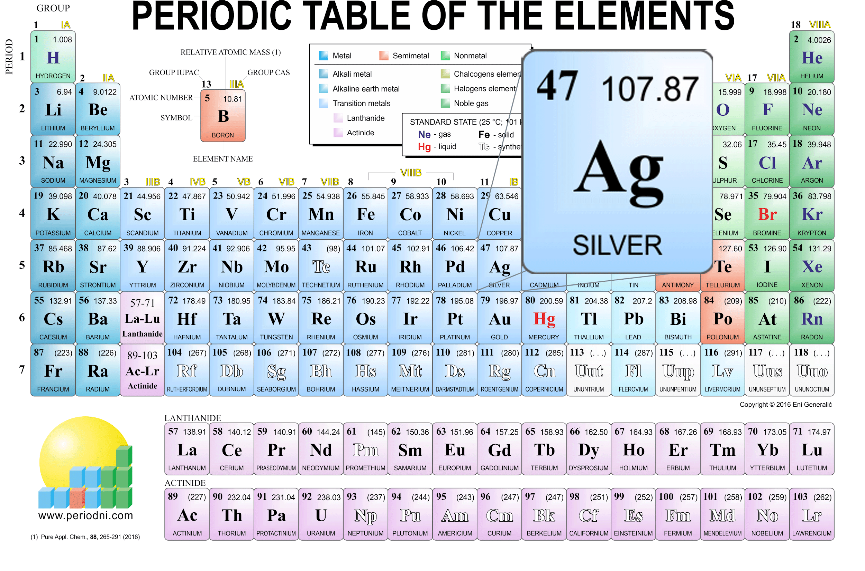
Accessibility Guidelines
=
AG
Notes:
Alt= “period table of elements with Ag symbol for Silver magnified.”
It’s a mnemonic -- the acronym for Accessibility Guidelines is AG, the chemical symbol Ag stands for Silver.
Image courtesy of http://www.periodni.com/images.html

Slide 4

Silver
Content
Easier to use
Easier to reference
Easier to understand
Expanded scope
Inclusive of more disabilities
Inclusive of more perspectives
Inclusive of more technologies
Useful for more people
Process & Structure
Based on evidence and data
Broadly communicate our efforts
Clear project milestones
Inclusive communication paths
Inclusive of more perspectives
Involve more stakeholders
Easier to maintain and update
Clearer update path
Notes:
https://www.w3.org/WAI/GL/wiki/Goals_for_Designing_the_Silver_Process

Slide 5
Silver Plan
1 Discovery Structure Content
2 Interpretation
3 Solutions
4 Prototypes
5 Writing Silver
Q3 Q4
2016
Q1 Q2 Q3 Q4
2017
Q1 Q2 Q3 Q4
2018
Q1 Q2 Q3 Q4
2019
Q1 Q2 Q3 Q4
2020
Notes:
Silver is progressing independent of AGWG focus on WCAG 2.1
If WCAG 2.2 happens, the Task Force expects that it will impact Phase 5 Q3 2018 - Q1 2019 timeline for writing the FPWD.

Slide 6
Research Done (Overview)
WCAG Use by UX Professionals (survey)
WCAG Success Criteria Usability Study (survey)
Internet of Things Accessibility (survey & interviews)
Interviews on Conformance
Interviews on Legacy of WCAG 2.0 Creation
Feedback from Reimagining Accessibility Guidelines Presentations
Web Accessibility Perceptions
Student research on Silver research questions (9 papers)

Slide 7
Problem Areas from Research Findings
Usability
Too Difficult to Read
Difficult to get started
Ambiguity in interpreting the success criteria
Persuading Others
Conformance Model
Strictly Testable Constraints
Human Testable
Accessibility Supported
Evolving Technology
Maintenance
Flexibility
Scaling
Governance

Slide 8
Design Sprint Video

Slide 9
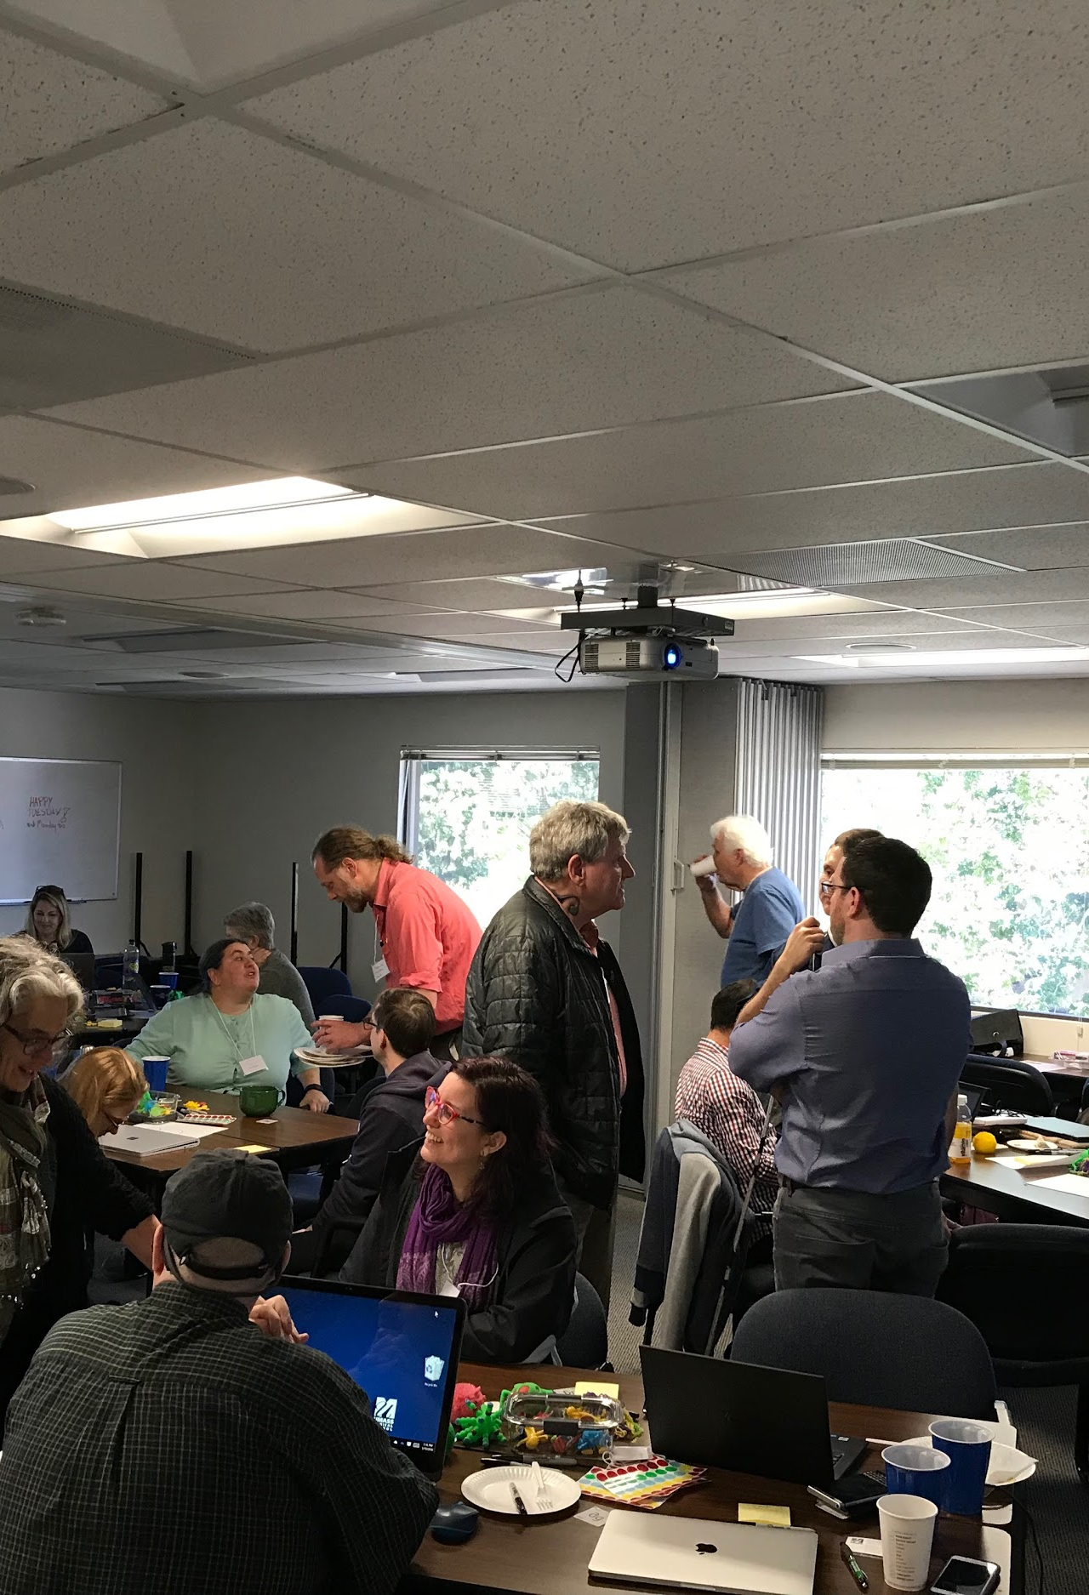
Design Sprint Explorations
Information architecture development
Flexibly filterable guidance
Development cycle focused navigation of guidance
Taking Accessibility Supported conformance out of an author responsibility
Role-based filtering of guidance
Avenues for contributions to guidelines contributions
Design studio workshops to get more people to contribute
Browser and assistive technology guidance
Flexible conformance model
Inclusion of user testing results for conformance
Notes:
Resources: Job Stories Problem Statements

Slide 10
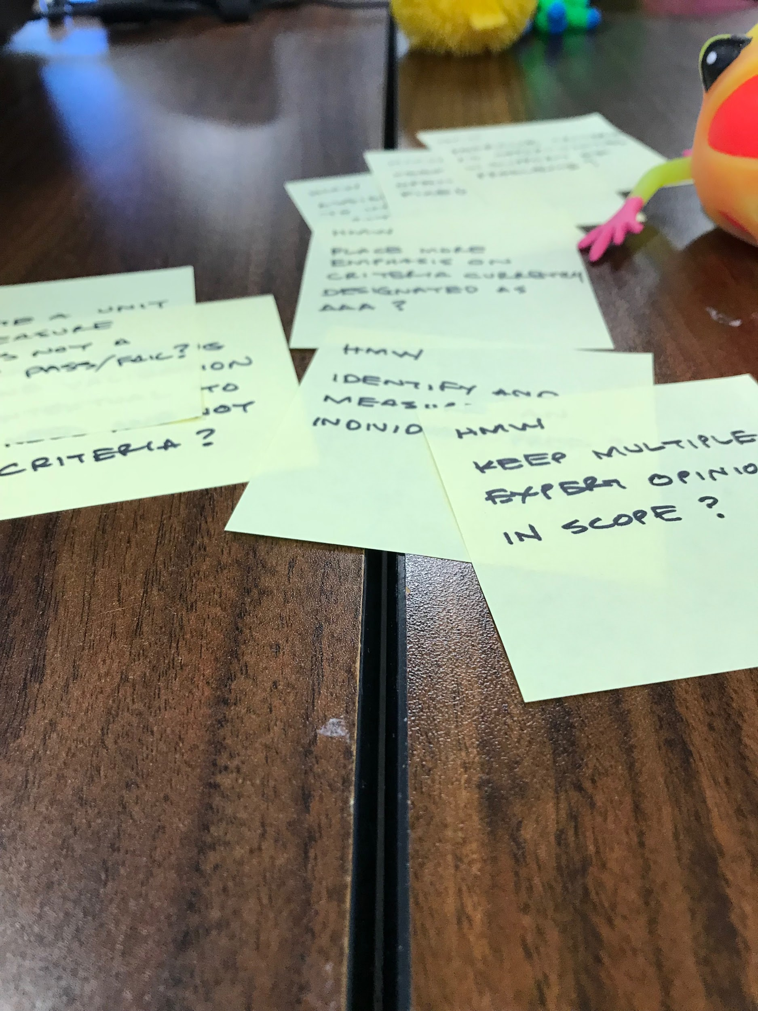
Recruiting
Silver Community Group
w3.org/community/silver
Information Architecture
Design
Development
Content help (starting this Fall)

Slide 11
Questions?
https://goo.gl/1dyJck
Shawn Lauriat, Jeanne Spellman, Jennison Asuncion

